Slide 1
ACT Updates & Insights:
TACRAO Summer Meeting
July 2026

Slide 2

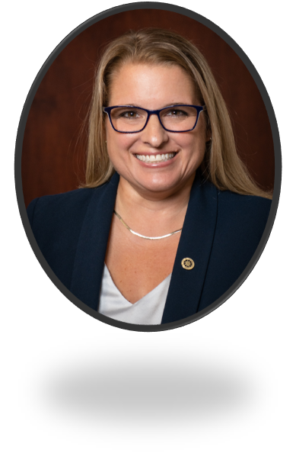
ACT Higher Ed Team
We are your direct contacts
  Navigating ACT
  Partnership opportunities
  Presentations
  Resources
Kasey Urquídez
Senior Director, Higher Ed
Kasey.Urquidez@act.org
Tara Lebar
Program Director, Higher Ed
Tara.Lebar@act.org
Notes:
We aren’t replacing the good work being done with Encoura, rather we are supplementing and supporting your needs with specific regard to t ACT

Slide 3

Today’s Topics
TACRAO SUMMER MEETING
ACT at a Glance
ACT Enhancements
ACT Data at your Fingertips
WorkKeys & NCRC
Programs & Updates

Slide 4

ACT joins ETS
Announced on July 1, 2026
ACT data will continue to be sent by Encoura as normal
Acquisition should not impact student experience or higher ed partners for the upcoming school year.
Notes:
No changes to ACT's structure for FY27. We remain intact and operating as ACT.

Slide 5
Seven decades of service
THE ACT LEGACY
ACT is a mission-driven organization founded in 1959 to help people achieve education and workplace success.
Grounded in more than 65 years of research, ACT is a trusted leader in college and career readiness solutions.
Each year, ACT serves millions of people through schools, government agencies, and employers worldwide.

Slide 6

Our mission and value proposition
NEW BRAND DIRECTION
ACT builds choices
to empower learners to understand their strengths and confidently shape their college and career success.
Notes:
“Helping people achieve education and workplace success.”

Slide 7
ACT by the Numbers
In 2025, approximately
4 million
ACT and PreACT tests were taken by students across the country.
The mission of ACT goes beyond helping students get to college.
We’re committed to preparing people for success in both college and career, wherever their pathways may lead. Our holistic solutions support learners at every stage, equipping them with the skills, credentials, and insights they need to thrive.
1.4m
seniors took the ACT test in 2025
1.1m
students took the ACT test through school-day testing
1.5 m+
ACT WorkKeys assessments were taken in Fiscal Year 2025

Slide 8
ACT by the Numbers
ACT reaches learners locally, nationally, and across the globe.
ACT assessments are delivered through multiple channels to meet the unique needs of learners, educators, and other stakeholders.
Whether at the national scale or through partnerships with states, districts, and international organizations, ACT meets learners where they are.
1m+
State & District Testing
State and district-wide school-day testing
745k+
National Testing
Saturday testing open to all students
29.5k+
International Testing
Global testing

Slide 9
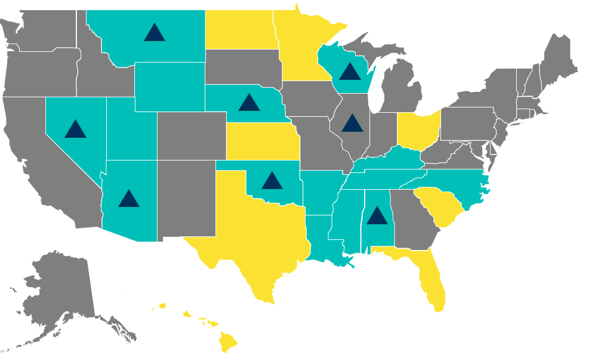
Participation and the average ACT Composite score remained fairly steady for the class of 2025, compared to the classes of 2024 and 2023.
ACT-tested students came from all 50 states, with more than two-thirds of graduates testing on a school day.
15
69
Tested 90%+ of 2025 graduates as part of a state testing program
(15 states)
STATES
PERCENT
Tested <90%+ of 2025 graduates as part of a state testing program (8 states)
Tested more than 90% of their graduates with the ACT.
of 2025 graduates took their most recent ACT test in a school-day administration, compared to 34% in 2016.
ACT used for ESSA accountability in 2024-25
(8 states)
Notes:
Learn More – ACT Policy Brief:
Impacts from the Rise of Statewide School-Day Testing

Slide 10
ACT Enhancements

Slide 11
Key Enhancements to the ACT
ACT ENHANCEMENTS
The ACT test has been modernized to provide more flexibility for the test taker, all while maintaining the same high level of accuracy and predictive power of the legacy test.
Reduced Number of Questions
More Time Per Question
Reduced Answer Choices for Math Questions
Science Test is Optional
Shortened Test Time

Slide 12
ACT Test Specifications
ACT ENHANCEMENTS
English
50 Items
35 Minutes
Math
45 Items
50 Minutes
Reading
36 Items
40 Minutes
Total
131 Items
125 Minutes
Optional:
84 Item & 50 Minute reduction from Legacy Core ACT administration
Science
40 Items
40 Minutes
Writing/Essay
1 Item
40 Minutes
Scoring Range: 1-12
Notes:
Need to share percentages of science taking & stats about S&D requiring science

Slide 13
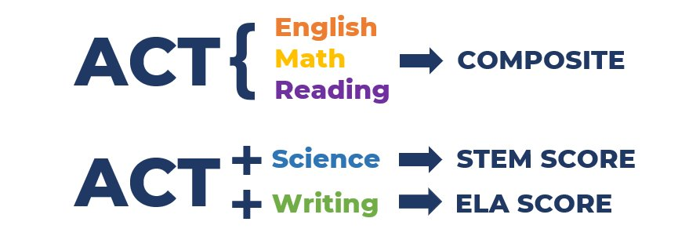
New Composite Score
ACT ENHANCEMENTS
The score scale remains 1-36
The ACT Composite score is now English, math, and reading.
Students who take the science section will receive a STEM score
Students who take the writing section will receive an ELA score.

Slide 14




What Stayed the Same?
ACT ENHANCEMENTS
ACT Scale and Benchmarks Remain Unchanged
Prior Test Scores Remain Unchanged
No Change in Predicting First-Year College Success
Both Paper and Online Tests Still Offered
Online Test is Linear, not adaptive

Slide 15
ACT Data at your fingertips

Slide 16
Higher Education Reports
ACT DATA
Annually ACT publishes the (Freshman) Class Report specifically for higher education institutions sharing ACT data from the students entering the previous fall for each college & university that meet the following parameters:
The school must send their enrollment data to the National Student Clearinghouse by November 1 each grad year.
Must have at least 30 ACT score senders enrolled at the institution (based on a match to the NSC data)
Notes:
Reports were sent out on Friday, June 26.

Slide 17
ACT Class Profile Report
ACT DATA
1
2
3
Recruitment/
Admission
Demographic data summarized by:
ACT Score Senders
Enrolled Students
Not Enrolled
Score sending behavior for competitor institutions & top feeder high schools.
Academic/ Student Support Services
Student Self-Reported
Educational aspirations
Intended major
Expectations for Financial Aid
Expectations for Work in college
Special assistance needed
Extracurricular plans
ACT Test Score Distribution/ Course Sequence
Deep Dive into the scores you received:
Overview of HS Coursework
Score breakdown by subject test
Performance relative to ACT Benchmarks
Notes:
Every qualifying institution would receive this report at a minimum. The most robust report of the three.
Almost 1800 institutions received reports this year.

Slide 18
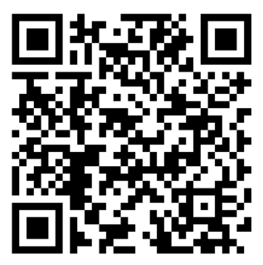
Score Send & Composite Score Reports
ACT DATA
Score Sending Report
Compares Score Senders and Non-Score Senders
ACT Composite Score
Within-year retention
*must have at least 75 ACT-tested students with 25 score senders & 25 non-score senders among your enrolled students
Composite Score & Superscore Report
Compare Legacy ACT (EMRS) to New ACT (EMR) for Fall 2023, 2024 & 2025 to examine differences in score distribution
*must have at least 30 ACT-tested students enrolled each year: Fall 2023, Fall 2024 & Fall 2025
Request a copy of your institution’s reports
Notes:
Score Sending will join the Class Profile report next year.
Composite Score Report will end once new ACT scores are established practice.
We will be reworking these reports next year so if there are additional metrics we should be preparing, let me know.
Scan here if you would like me to send you a copy of your reports.

Slide 19
ACT Graduating Class Data
ACT DATA
ACT releases U.S. graduating class data at the district, state, and national levels each fall. The annual graduating class data release is part of ACT’s commitment to provide meaningful data for institutions and stakeholders to make informed decisions to improve student outcomes.
What’s Reflected in the Annual ACT Graduating Class Data
Students who graduated in 2025 and took the ACT between 10th and 12th grade
The most recent ACT test score for each student
All students, public and private
What States and Districts Can Do with ACT Graduating Class Data
Analyze participation, scores and benchmark attainment, and postsecondary outcomes
Map student achievement to state and district goals and other data sources
Identify state and district successes, opportunities for growth, and areas to investigate

Slide 20
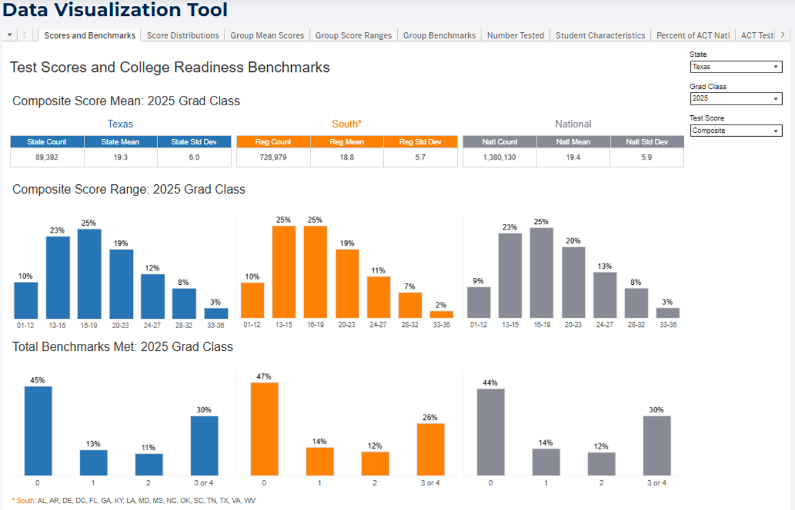
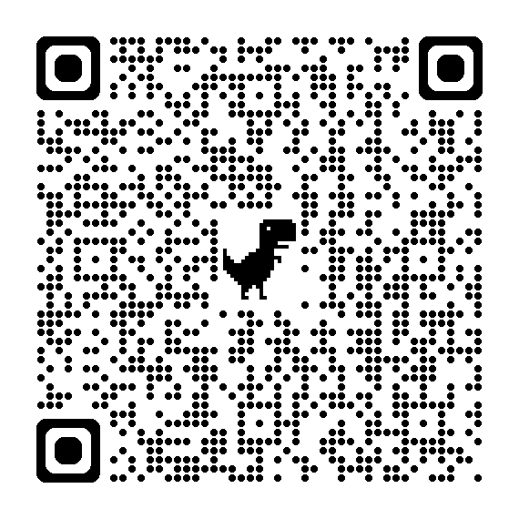
ACT Graduating Class Data
ACT DATA
Break down the Grad Class Data for your needs!
View your State's Grad Class Data
Compare with regional & national data
See tabs above for data configuration options
Scan the QR code to begin:
Notes:
Texas tested 90k students
22% of 2025 graduates took the ACT
State contract for ACT (district choice)

Slide 21
WorkKeys & NCRC

Slide 22




WORKKEYS & NCRC
WorkKeys Assessments
WorkKeys National Career Readiness Certificate
A system of assessments, curriculum and skills profiling that determine, build, and measure essential workplace skills that can affect your job performance and increase opportunities for career changes and advancement.
WorkKeys
Profiling
WorkKeys Curriculum

Slide 23
WorkKeys used in:
WORKKEYS & NCRC
High Schools
Secondary education readiness assessments
Adult Education
IET/CTE – high school & post-secondary ed
Pre-Apprenticeships
IET/CTE – high school & post-secondary ed
Community College
Career pathway & certified programs of study
Corrections
RE-Entry, juvenile, state & federal
Workforce Development
Training programs & upskilling
Employers
Pre-hire assessment & incumbent worker upskilling
Business Services
Customized training for employees

Slide 24
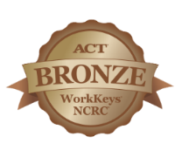
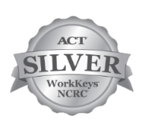
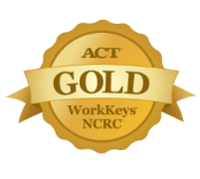
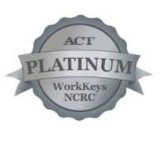



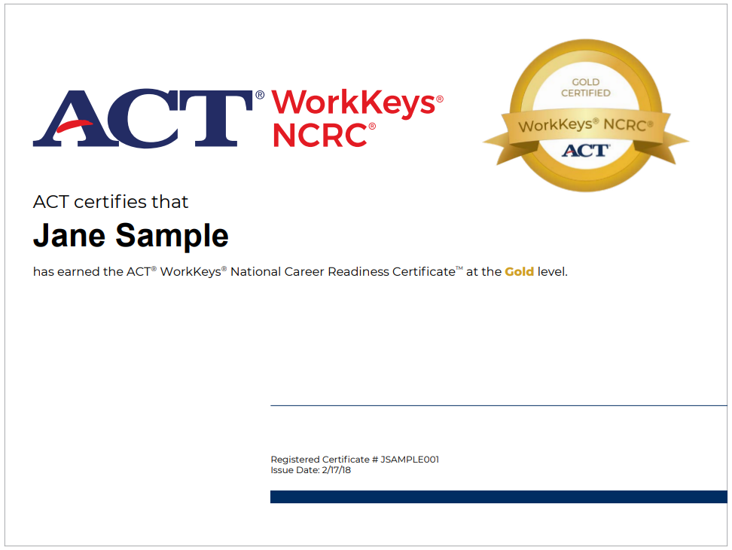




National Career Readiness Certificate (NCRC)
WORKKEYS & NCRC
Applied Math
Graphic Literacy
Workplace Documents

Slide 25
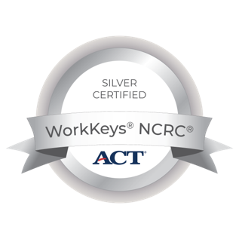
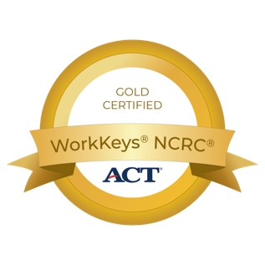
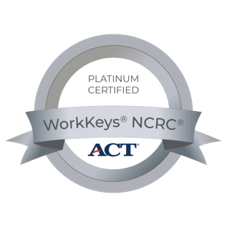
College Credit through NCRC & WorkKeys
WORKKEYS & NCRC
3 SEMESTER HOURS
Up to 1 college credit hour in each:
Quantitative Reasoning
Information Literacy
Professional Writing
6 SEMESTER HOURS
Up to 2 college credit hours in each:
Quantitative Reasoning
Information Literacy
Professional Writing
9 SEMESTER HOURS
Up to 3 college credit hours in each:
Quantitative Reasoning
Information Literacy
Professional Writing

Slide 26
Programs & Updates

Slide 27

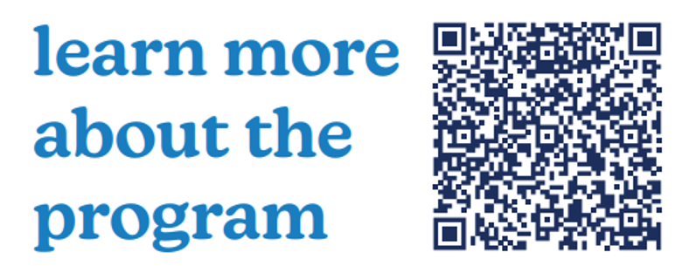
PreACT Rising Star Program
PROGRAMS & UPDATES
Designed to recognize & celebrate students who excelled on the PreACT 8/9
Notes:
Scan the code to learn more about the program and see if there are winners near you.

Slide 28
Research Partnership Opportunities
PROGRAMS & UPDATES
ACT is inviting 2-year and 4-year institutions to participate in research data sharing partnerships. You share a student-records extract in return your office receives institution-specific data & reporting. What your Institution Receives:
1
2
Custom ACT data file for your enrolled Students
ACT scores plus student background info for every enrolled student-formatted for your IR team to link directory to your own outcomes
Uses: validate course placement, model predictors of persistence and examine equity gaps – analyses most campuses can’t run without the score data.
A score-sender vs. non-sender outcomes report
An institution-specific report comparing the outcomes of students who submitted ACT scores against those who did not.
Uses: ground your test-optional / test required policy in evidence from your own students – not national averages
No cost to your institution. ACT does the analysis and returns a report for your campus.
Notes:
Pick up a flyer to take back to your institution. It has a QR code to set up a quick introductory meeting for your team to learn more.

Slide 29
Regional Conference Opportunities
PROGRAMS & UPDATES
New this year!
The 2026 ACT Regional Conference – San Antonio offers K-12, Higher Education & Workforce leaders the opportunity to exchange ideas, deepen their knowledge, and explore real-world solutions to today’s most pressing problems!
Perfect Professional Development for:
Emerging Enrollment leaders
Middle Managers,
Workforce Professionals
College Navigators
San Antonio, TX
Oct 22, 2026
UTSA Campus

Slide 30
Regional Conference Opportunities
PROGRAMS & UPDATES
1
Higher Education
Enrollment Forum
2
Half-day, Higher Ed Enrollment workshop within the one-day conference
Guest Speakers
Local Enrollment Leaders
Collaborative Curriculum
Designed by Higher Ed for Higher Ed!
3
Locations
Tempe, AZ
Tuscaloosa, AL
Tulsa, OK
4

Slide 31
Your Higher Ed Support Team
Tara Lebar
Program Director,
Higher Education
tara.lebar@act.org
Kasey Urquídez, Ed.D.
Senior Director,
Higher Education
kasey.urquidez@act.org

