Slide 1
TACRAO Residency Committee: Updates
Morning Session: 10:30-11:30
Ballroom 1-4

Slide 2
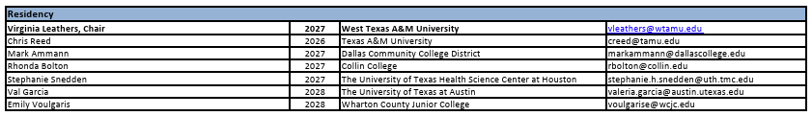
Residency Committee and Members
Residency Committee will have four to six members and a chair with representation from both 2-year and 4- year institutions. The chair will serve for three years, and each member will serve two years. The committee ensures that issues and developments surrounding the determination of student residency for tuition purposes in Texas are monitored and addressed. It facilitates discussions, provides resources, and serves as a platform for sharing expertise to assist TACRAO members in navigating residency challenges.

Slide 3
Residency Committee 2026 Objectives:
Updating the institution list of residency contacts
Create a best practice Q&A for rule releases
Provide training / session options at the TACRAO 2026 Annual Conference

Slide 4
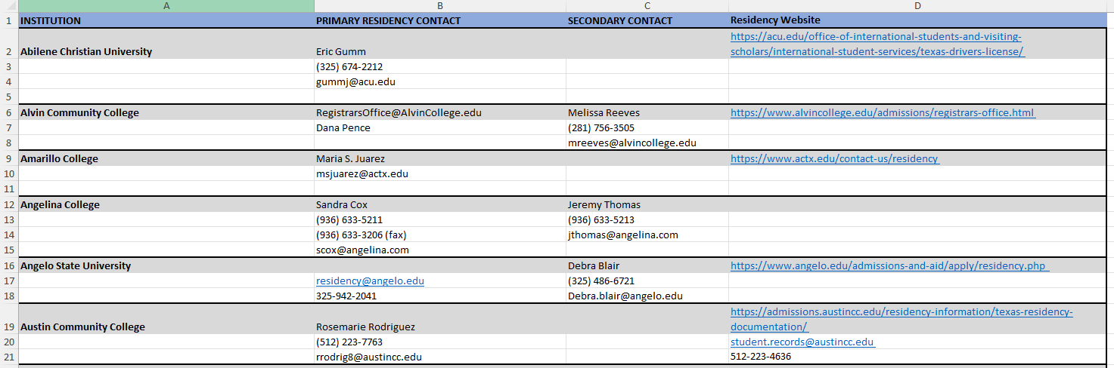
New Institution Residency List
Reviewed institutions websites and catalogs
Has primary, secondary (if available), and residency website or catalog info links
Working on where it will be saved on the TACRAO website

Slide 5
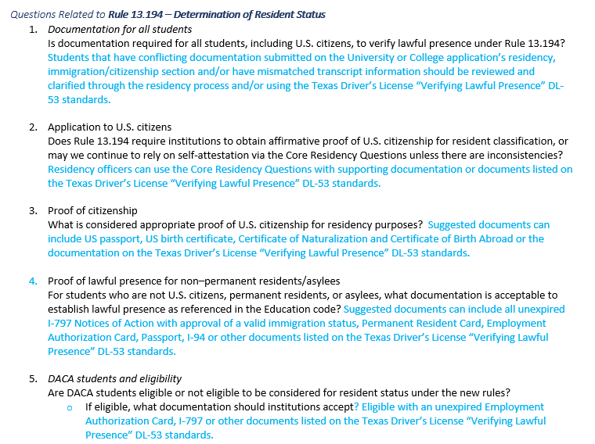
TACRAO Residency Q&A for Rule Releases

Slide 6
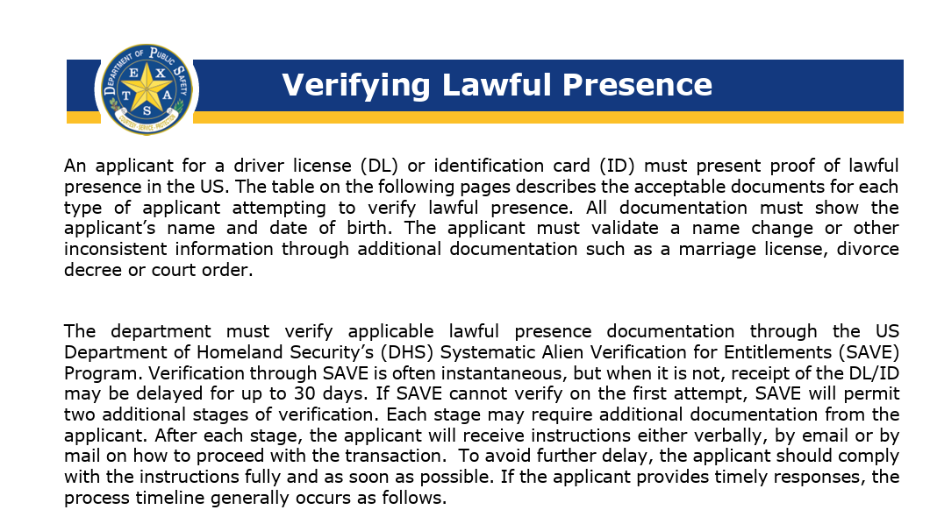
Documentation Sources:
Texas Driver’s License Verifying lawful Presence: https://www.dps.texas.gov/section/driver-license/us-citizenship-or-lawful-presence-requirement
THECB: https://www.highered.texas.gov/texas-residency/
My TX Future: https://www.mytexasfuture.org/middle-high-school/explore-financial-aid/apply-for-financial-aid/residency-information/
Housing: lease or rental agreements spanning the entire 12-month period, mortgage statements, property tax receipts, closing papers, utility bills
Employment: Letter of employment with start and continuing dates, 12 months of paystubs.
Military IDs, DD214, LES statements
Financials: Bank statements showing continuous state residency, tax returns for year and dependency, public assistance documents for social service agencies
Marriage certificate or declaration of registration of informal marriage
Voter registration
High school transcripts for the person’s full senior year or twelve months or thirty-six months presence in the state and graduation from a Texas high school

Slide 7

Residency Sessions at Houston TACRAO
Residency Basics
Join the TACRAO Residency Committee for an engaging walk-through of the not-so-basic "basics" of residency determination. Whether you're new to residency or looking for a refresher, this session will explore the foundational concepts, regulations, and resources that guide residency decisions in Texas higher education.
Topics will include:
What is residency?
Key regulations and requirements
Waivers and exemptions
Helpful resources
Five basic residency cases
Through practical examples and real-world scenarios, participants will gain a stronger understanding of residency principles and the confidence to navigate residency questions with greater clarity and consistency.

Slide 8
Residency Sessions at Houston TACRAO
Residency Advanced
Join the TACRAO Residency Committee for a session focused on the more complex and nuanced aspects of residency determination. This session will explore challenging situations that require careful analysis, consistent application of regulations, and sound institutional practices.
Topics will include:
Best Practices for Determining Residency
7 Scenarios
Identifying and Addressing Residency Errors
  Defining residency errors
  Backdating residency classifications
  Institution Policy / Catalog Considerations
Through practical case studies and discussion, attendees will gain a deeper understanding of complex residency issues, strengthen their decision-making skills, and learn strategies for handling residency determinations with greater confidence and compliance.

Slide 9
TACRAO Residency Committee: Scenarios and Q&A
Afternoon Session: 1:00-2:00pm
Ballroom 1-4

Slide 10


Slide 11

Let’s Play a Game
We’re going to ask you about 5 residency situations.
As a group we’ll discuss and ask questions.
You may not have all the information you’d like to have.
You can assume all the information we have is verified.
After each situation, we’ll vote as a group if they are a resident or not.

Slide 12
Let’s Start With an Easy One
A student is a dependent minor of a Texas resident but resided outside of Texas during high school. They are applying as a freshman with no credit hours.

Slide 13
One More to Warm Up
A student attended a Texas college for two years and was classified as a resident. They left the country for a 6-month mission trip returning in the middle of their 2nd long semester of absence. They’ve applied as a re-admit.

Slide 14
Getting a Little More Difficult Now
A student is an emancipated minor. They have resided in Texas for 12 months but have no clear means of support. They have a lease and utility bills showing supporting domicile.

Slide 15
Now We’re Rolling
A student enrolled at a Texas 4-year college as a resident. After their sophomore year they enrolled at another 4-year college out of state where they remained for 18 months. They have applied for re-admission.

Slide 16
Let’s Bring it Home Now
A student is on a B1 visa which has expired and previously enrolled at a community college in Texas where they were granted “in-district” status. They have applied for asylum but have not been granted it yet.

Slide 17
Easy Job Right? Well Done!

